Slide 1
BlindType
Eyes-Free Text Entry on Handheld Touchpad by Leveraging Thumb's Muscle Memory
Yiqin Lu, Chun Yu, Xin Yi, Yuanchun Shi, Shengdong Zhao

Slide 2
How to input text?
Notes:
打字成为比不可少的
某些场景

Slide 3
How to input text?
Constrained!
Notes:
视觉受限
盲输入

Slide 4
Eyes-free typing leveraging fingers’ muscle memory
Eyes-free?
Notes:
触摸屏已经成为标准

Slide 5
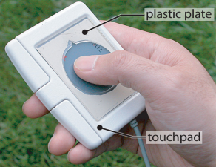
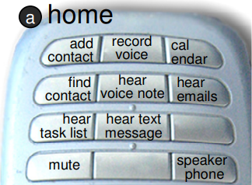
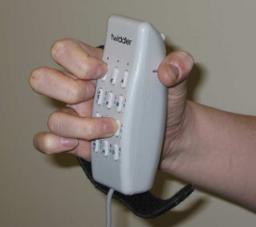
Related Work
Tangible eyes-free inputs
EarPod
Blindsight
Twider & Mini-qwerty
[1] S Zhao, P Dragicevic, M Chignell, R Balakrishnan, and P Baudisch. 2007. Earpod: Eyes-free Menu Selection Using Touch Input and Reactive Audio Feedback. (CHI 07) [2] K A. Li, P Baudisch, and K Hinckley. 2008. Blindsight: Eyes-free Access to Mobile Phones. (CHI ’08) [3] J Clawson, K Lyons, T Starner, and E Clarkson. 2005. The impacts of limited visual feedback on mobile text entry for the twiddler and mini-qwerty keyboards. (ISWC’05)

Slide 6
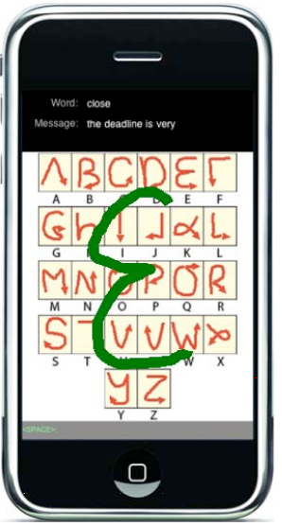
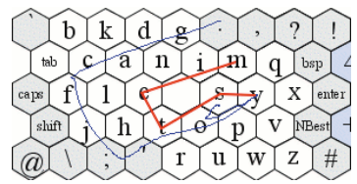
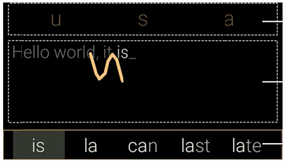
Related Work
Gesture-based inputs
SHARK²
1D Handwriting
2D Handwriting
[1] P Kristensson and S Zhai. 2004. SHARK2: A Large Vocabulary Shorthand Writing System for Pen-based Computers. (UIST ’04) [2] H Tinwala and I. S MacKenzie. 2010. Eyes-free Text Entry with Error Correction on Touchscreen Mobile Devices. (NordiCHI ’10)
[3] C Yu, K Sun, M Zhong, X Li, P Zhao, and Y Shi. 2016. One-Dimensional Handwriting: Inputting Letters and Words on Smart Glasses. (CHI ’16)

Slide 7
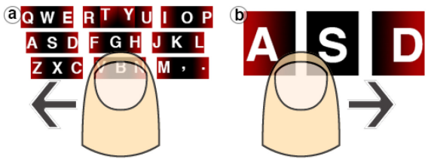
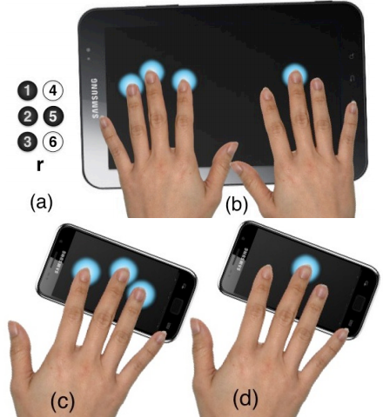
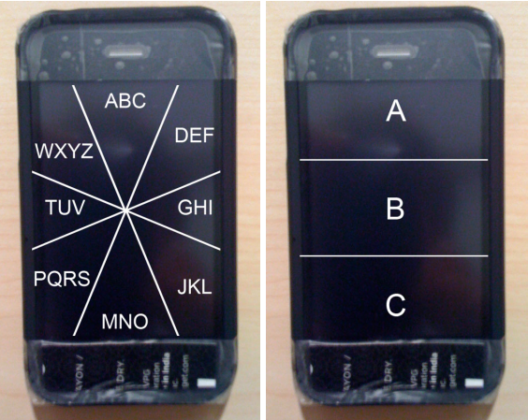
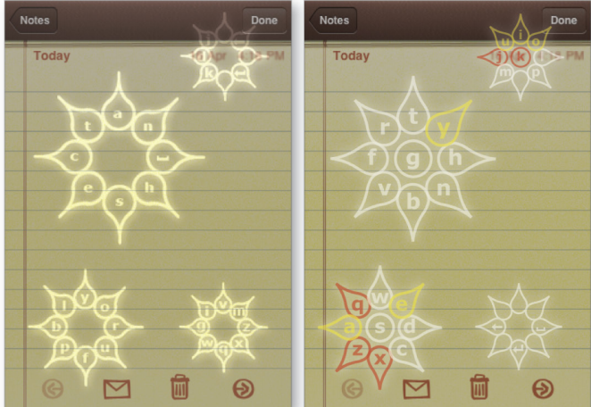
Related Work
Grouping and encoding methods
Swipe Keyboard
Braille Input
No-look Notes
Escape-Keyboard
[1] N Banovic, K Yatani, and K N Truong. 2013. Escape-keyboard: A sight-free one-handed text entry method for mobile touch-screen devices. (IJMHCI) [2] S Azenkot, J O. Wobbrock, S Prasain, and R E. Ladner. 2012. Input Finger Detection for Nonvisual Touch Screen Text Entry in Perkinput. (GI ’12) [3] M N Bonner, J T Brudvik, G D Abowd, and W K Edwards. 2010. No-look notes: accessible eyes-free multi-touch text entry. (International Conference on Pervasive Computing) [4] T Grossman, X Anthony Chen, and G Fitzmaurice. 2015. Typing on Glasses: Adapting Text Entry to Smart Eyewear. (MobileHCI ’15)

Slide 8
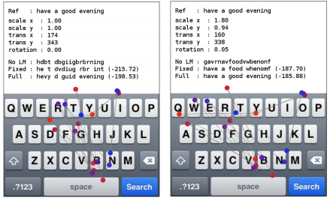
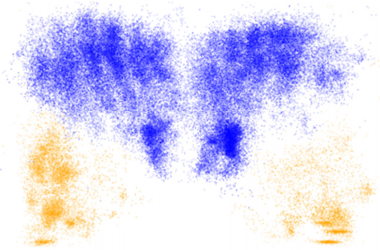
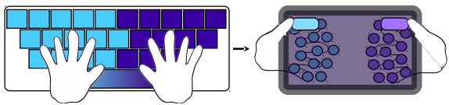
Related Work
Behaviors on touchscreens
Eyes-free Typing
Ten-finger Typing
Sandwich Keyboard
[1] L Findlater, J O. Wobbrock, and D Wigdor. 2011. Typing on Flat Glass: Examining Ten-fnger Expert Typing Patterns on Touch Surfaces. (CHI ’11) [2] O Schoenleben and A Oulasvirta. 2013. Sandwich Keyboard: Fast Ten-fnger Typing on a Mobile Device with Adaptive Touch Sensing on the Back Side. (MobileHCI ’13) [3] Keith Vertanen, Haythem Memmi, and Per Ola Kristensson. 2013. The Feasibility of Eyes-free Touchscreen Keyboard Typing. (ASSETS ’13)

Slide 9
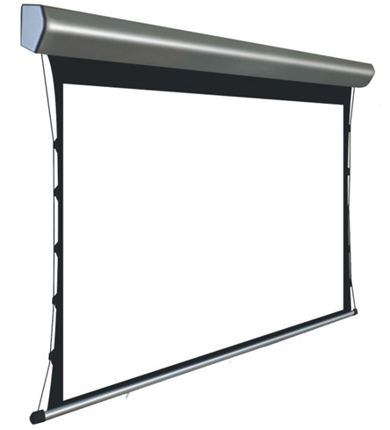
Can people type eyes-freely?
Can users transfer their typing ability from daily use to eyes-free?
What typing patterns will emerge?
Can we leverage the existing text entry algorithm to decode user’s eyes-free input? Or do we need a new algorithm?
Notes:
研究盲打这个问题本身很难
设想场景

Slide 10
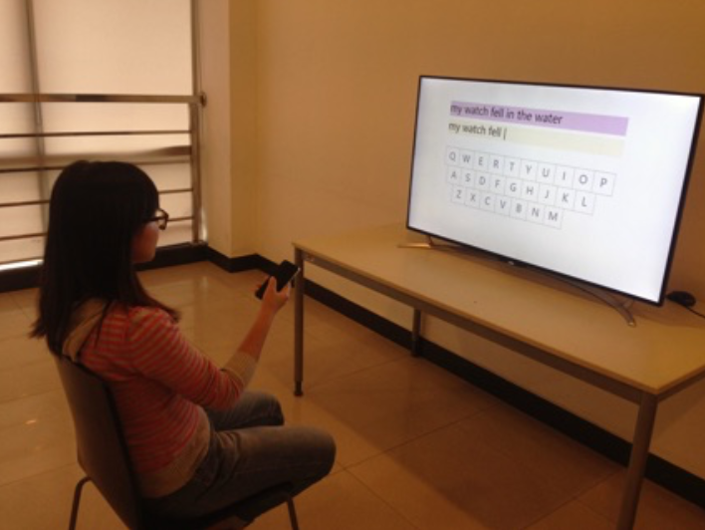
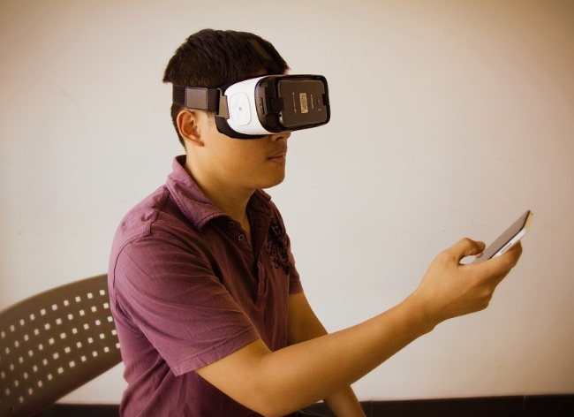
Can people type eyes-freely?
Public
Private

Slide 11
Study
1
Collecting Data

Slide 12
Study
1
Goal: Collecting users’ eyes-free typing data
Participant: 12 (11 males and 1 female)
Task: Finish 150 phrases eyes-freely
Design:
Mock-up system
Display always correct characters
Encourage users to correct errors
No visual point feedback on TV
No feedback on the touchpad
[1] I.S. MacKenzie, R.W. Soukore .2003. Phrase Sets for Evaluating Text Entry Techniques. (CHI EA ’03)
Notes:
从MacKenzie

Slide 13
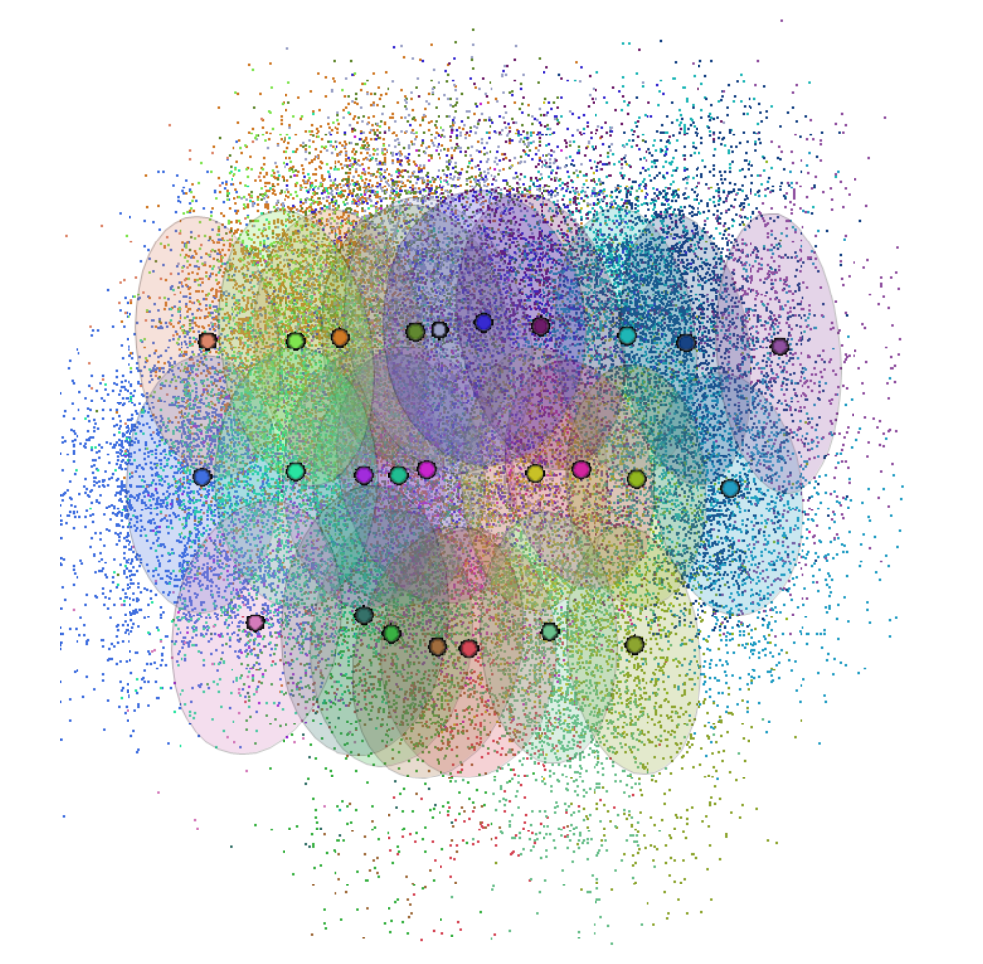
Study
1
Eyes-Free Typing

Slide 14
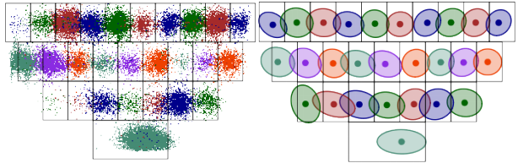
Study
1
Eyes-Free Typing
Eyes-Focus Typing
[1] S Azenkot and S Zhai. 2012. Touch Behavior with Diﬀerent Postures on Soft Smartphone Keyboards. (MobileHCI ’12)
Notes:
用户到底是不是在打QWERYY上打？

Slide 15
Study
1
Standard Keyboard
User Keyboard

Slide 16
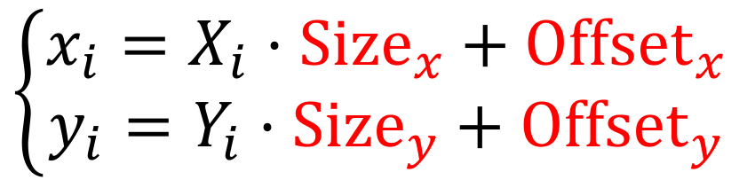
Study
1
Standard Keyboard
$$\left\{\begin{aligned}x_{i}=X_{i}·{Size}_{x}+{Offset}_{x} \\ y_{i}=Y_{i}·{Size}_{y}+{Offset}_{y}\end{aligned}\right.$$
User Keyboard

Slide 17
Study
1
 | Individual User |  | Pooled User
Axis | X | Y | X | Y
Key Size (mm) | 3.77 (0.57) | 9.62 (2.04) | 3.77 | 9.57
Offset (mm) | 9.89 (3.86) | 56.91 (6.49) | 9.90 | 57.10
R² Value | 0.963 (0.023) | 0.994 (0.005) | 0.982 | 0.998

Slide 18
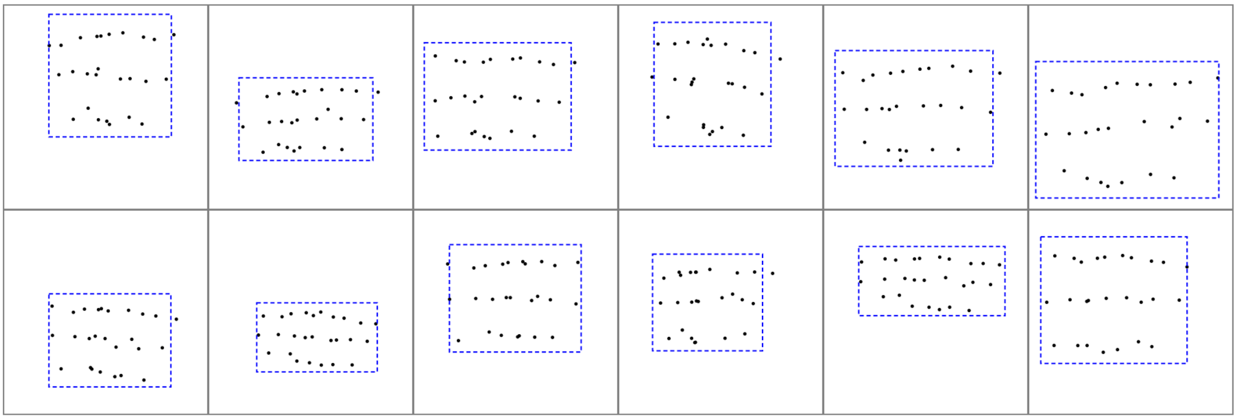
Study
1
 | Individual User |  | Pooled User
Axis | X | Y | X | Y
Key Size (mm) | 3.77 (0.57) | 9.62 (2.04) | 3.77 | 9.57
Offset (mm) | 9.89 (3.86) | 56.91 (6.49) | 9.90 | 57.10
R² Value | 0.963 (0.023) | 0.994 (0.005) | 0.982 | 0.998

Slide 19
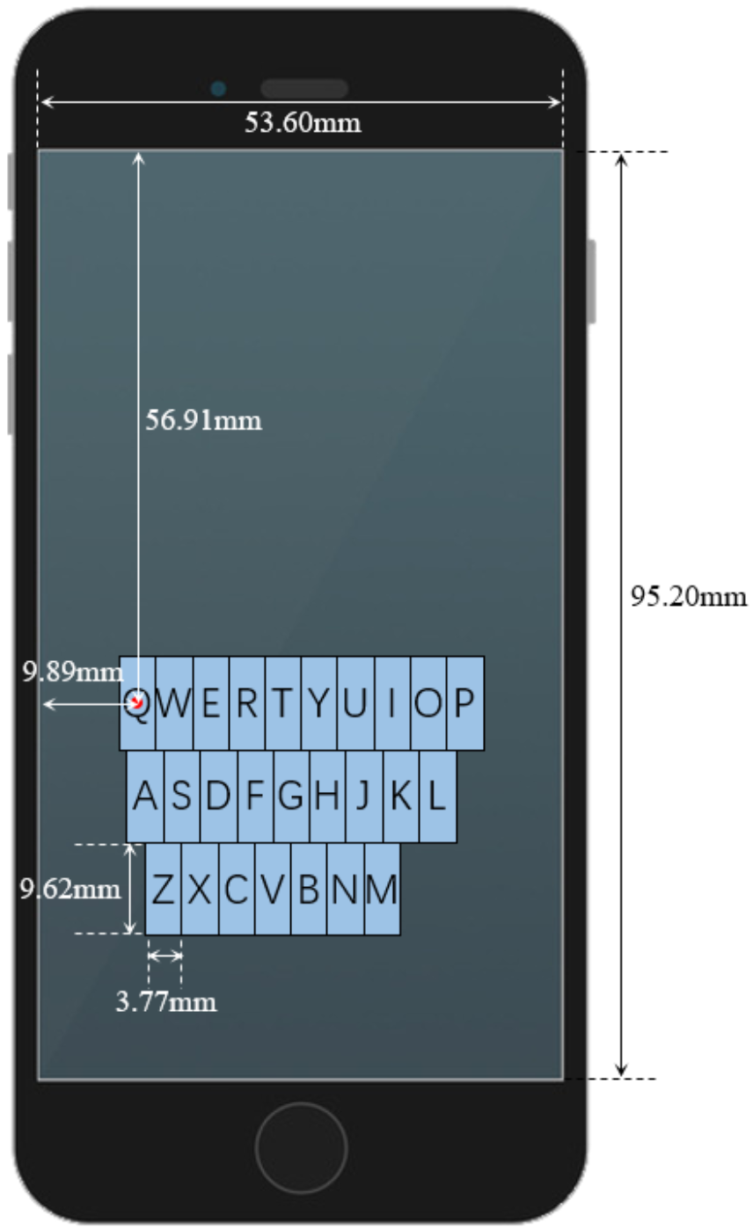
Study
1

Slide 20
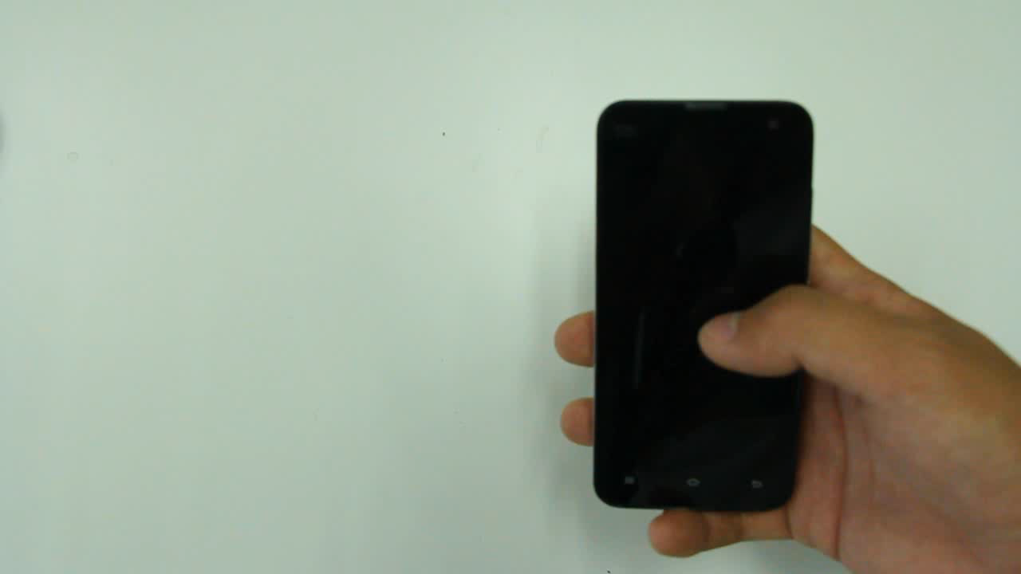
How is user’s typing
behavior? An example
“I skimmed through
your proposal”
Notes:
绝对位置吗？

Slide 21
Example “void”

Slide 22
Example “void”
Does the position of user’s current tap refer to the position of the previous tap?

Slide 23
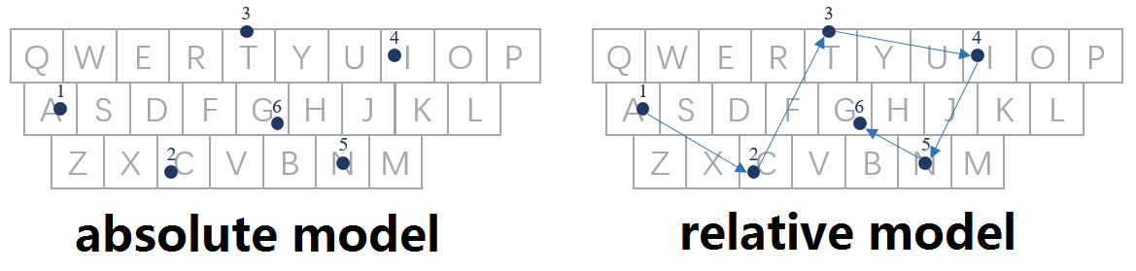
Example “acting”
Notes:
对于相对模型，同样可以拟合一个键盘

Slide 24
 |  | Absolute |  | Relative
 |  | X | Y | X | Y
Individual User | Key Size (mm) | 3.77 (0.57) | 9.62 (2.04) | 3.92 (0.60) | 9.30 (1.98)
 | Key STD (mm) | 3.03 (0.43) | 3.66 (1.17) | 3.43 (0.42) | 2.77 (0.42)
 | R² Value | 0.963 (0.023) | 0.994 (0.005) | 0.986 (0.007) | 0.999 (0.001)
Pooled User | Key Size (mm) | 3.77 | 9.57 | 3.91 | 9.24
 | Key STD (mm) | 4.31 | 7.01 | 4.52 | 3.80
 | R² Value | 0.982 | 0.998 | 0.992 | 0.999

Slide 25
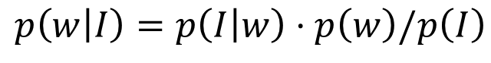
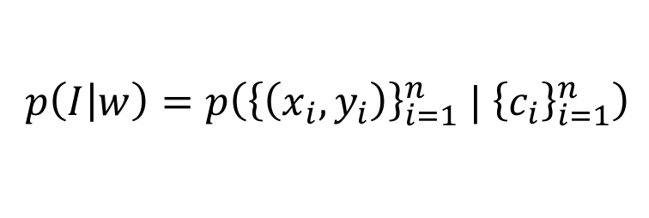
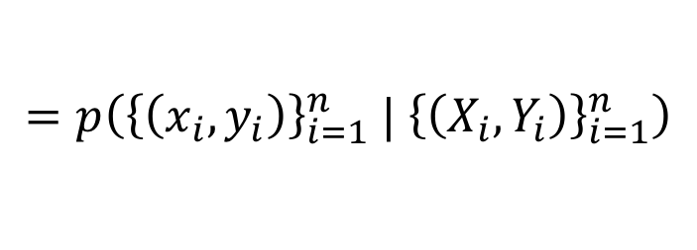
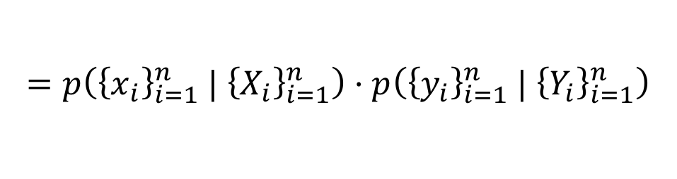
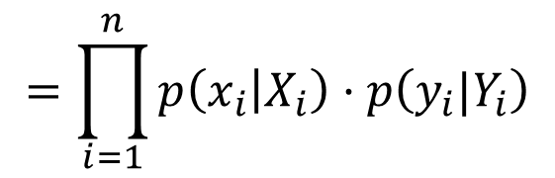
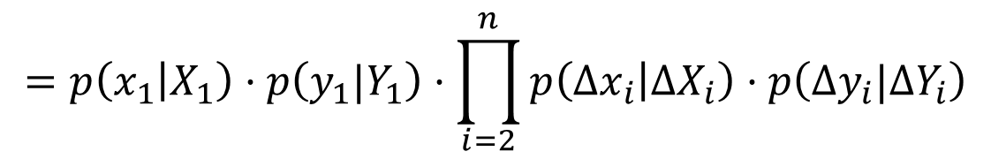
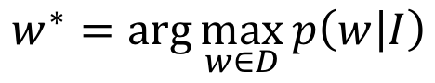
$$w^{∗}=\arg{\max_{w∈D}{p\left(w | I\right)}}$$
Algorithm
$$p\left(w | I\right)=p\left(I | w\right)·p\left(w\right)/p\left(I\right)$$
$p\left(I | w\right)=p\left({\left\{\left(x_{i},y_{i}\right)\right\}}_{i=1}^{n} | {\left\{c_{i}\right\}}_{i=1}^{n}\right)$
$$=p\left({\left\{\left(x_{i},y_{i}\right)\right\}}_{i=1}^{n} | {\left\{\left(X_{i},Y_{i}\right)\right\}}_{i=1}^{n}\right)$$
$$=p\left({\left\{x_{i}\right\}}_{i=1}^{n} | {\left\{X_{i}\right\}}_{i=1}^{n}\right)·p\left({\left\{y_{i}\right\}}_{i=1}^{n} | {\left\{Y_{i}\right\}}_{i=1}^{n}\right)$$
absolute
$$=\prod_{i=1}^{n}{p\left(x_{i} | X_{i}\right)·p\left(y_{i}|Y_{i}\right)}$$
relative
$$=p\left(x_{1} | X_{1}\right)·p\left(y_{1}|Y_{1}\right)·\prod_{i=2}^{n}{p\left({∆x}_{i} | ∆X_{i}\right)·p\left(∆y_{i}|∆Y_{i}\right)}$$
[1] J Goodman, G Venolia, K Steury, and C Parker. 2002. Language Modeling for Soft Keyboards. (IUI ’02)

Slide 26
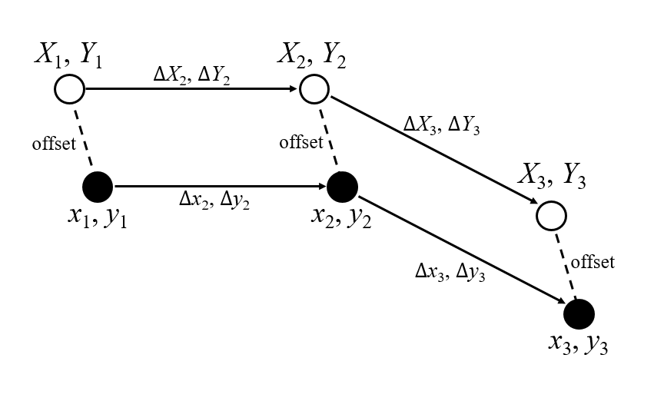
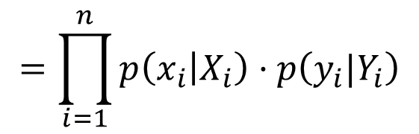
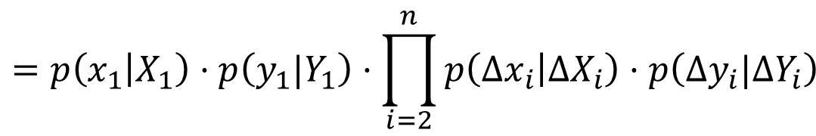
absolute
$$=\prod_{i=1}^{n}{p\left(x_{i} | X_{i}\right)·p\left(y_{i}|Y_{i}\right)}$$
relative
$$=p\left(x_{1} | X_{1}\right)·p\left(y_{1}|Y_{1}\right)·\prod_{i=2}^{n}{p\left({∆x}_{i} | ∆X_{i}\right)·p\left(∆y_{i}|∆Y_{i}\right)}$$

Slide 27
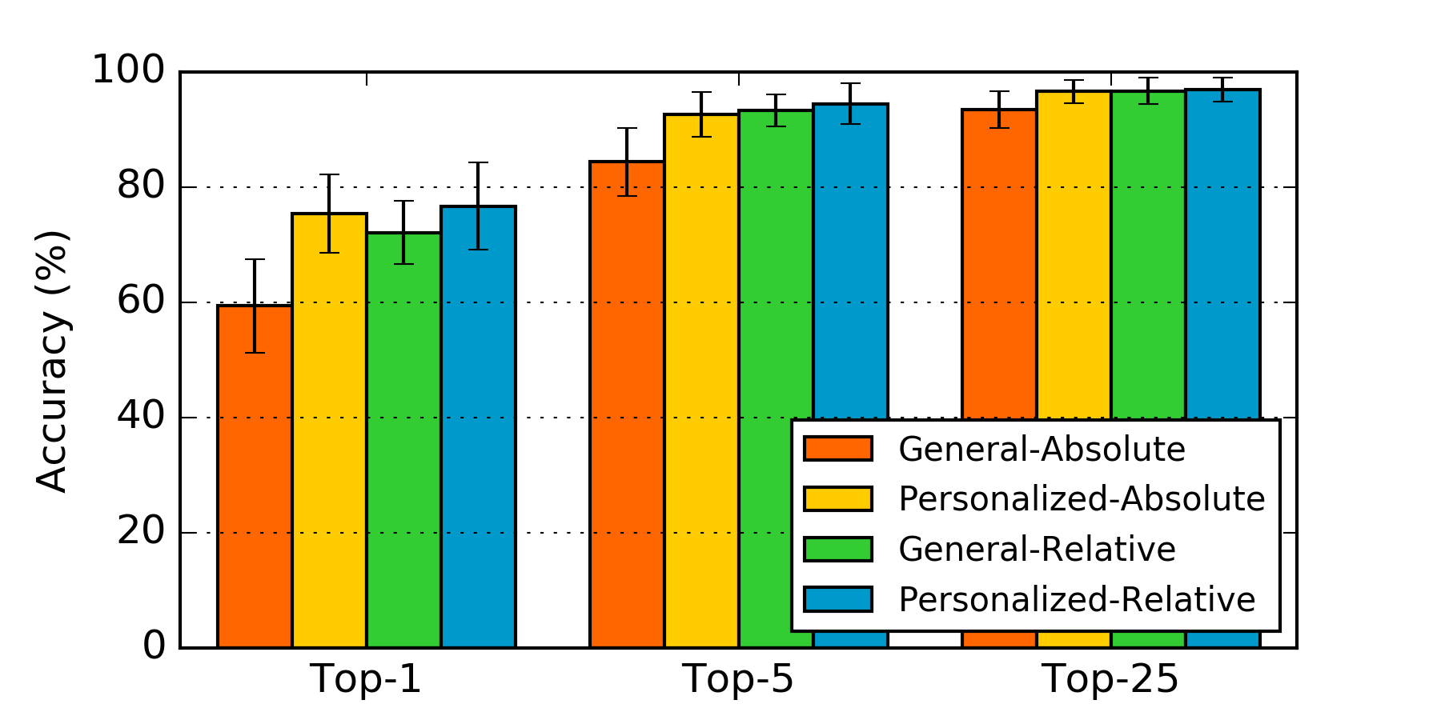
Absolute
General
Simulation
Relative
Personalized
Notes:
两个变量

Slide 28
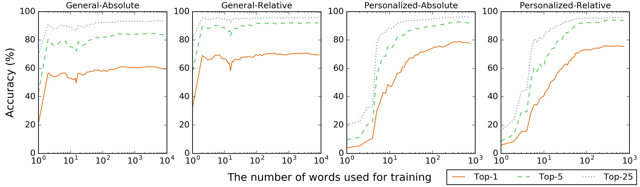
Simulation

Slide 29
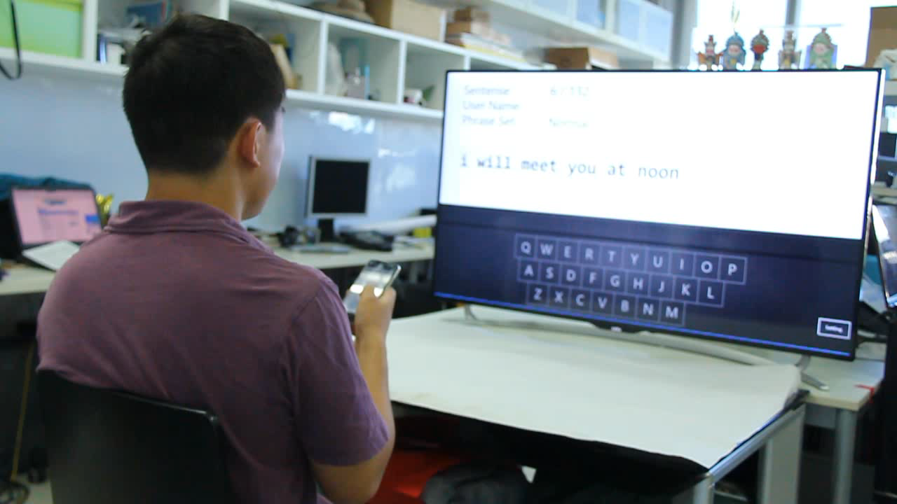
Study
2
TV Scenario

Slide 30
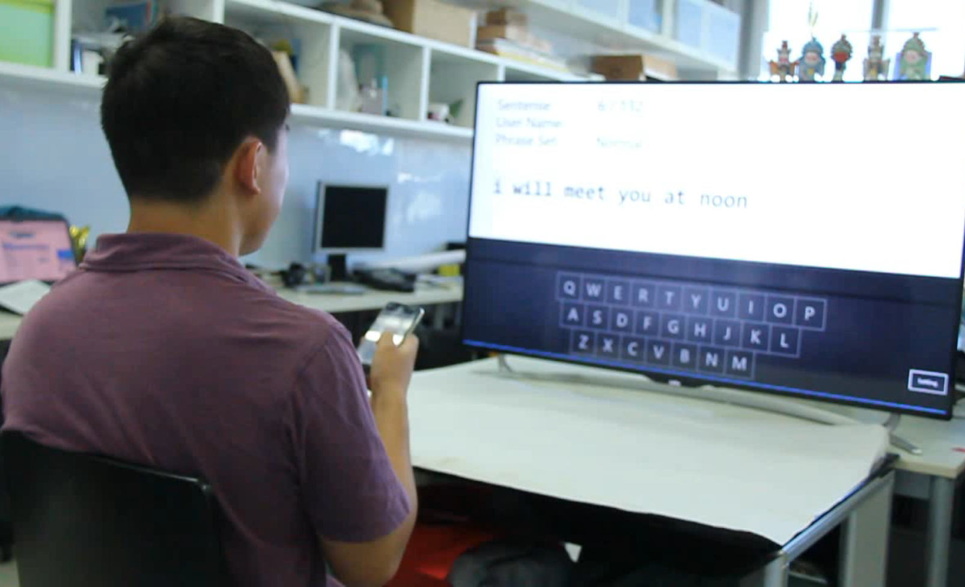
Goal: Evaluating the performance of the general algorithm
Participant: 16 (11 males and 5 female)
Task: Finish 40 phrases with each technique
Factor: Techniques (absolute, relative, baseline)
Design:
With word selecting phase
Type as fast as possible
Type as accurate as possible
Study
2

Slide 31
Study
2

Slide 32
Study
2

Slide 33
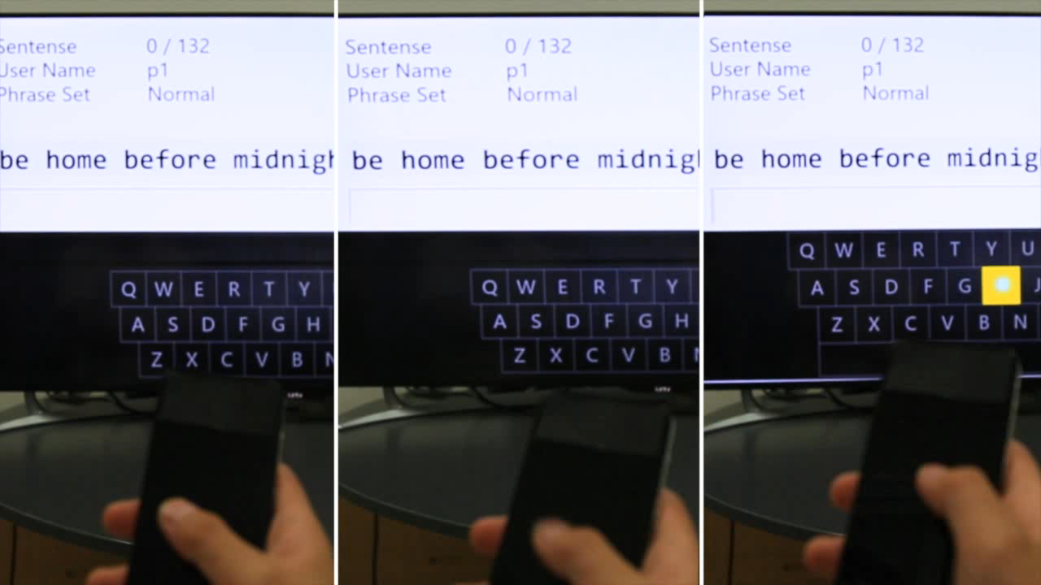
Absolute
Relative
Baseline
Study
2

Slide 34
 | Absolute | Relative | Baseline
Corrected Error | 6.11% | 5.13% | 3.11%
Uncorrected Error | 1.69% | 0.51% | 0.21%
Prediction Error | 4.09% | 2.09%
Could Not Enter | 0.30% | 0.06% | 0.00%
Study
2

Slide 35
“ My visual attention was mostly focused on the text feedback and candidate list.”
“ I occasionally referred to the keyboard when they were unsure of the keyboard layout.”
“ I am willing to use such a text entry in the future.”
“ I can not believe I have the ability of eyes-free typing.”
“ I could type eyes-freely even I did not remember the position of the key. ”
“ I feel the relative one was a little better than the absolute one.”
…
Study
2

Slide 36
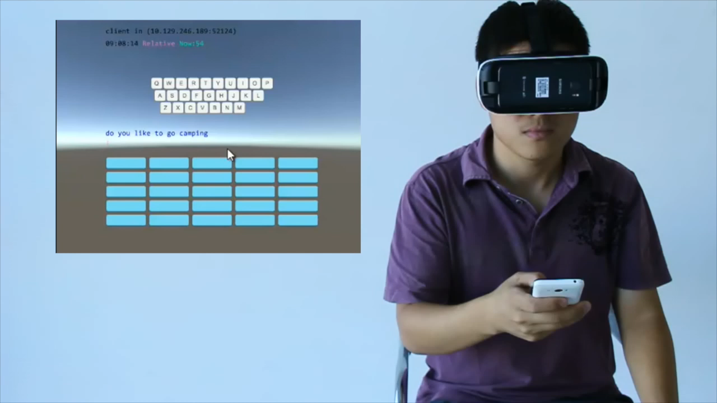
Study
3
VR Scenario

Slide 37
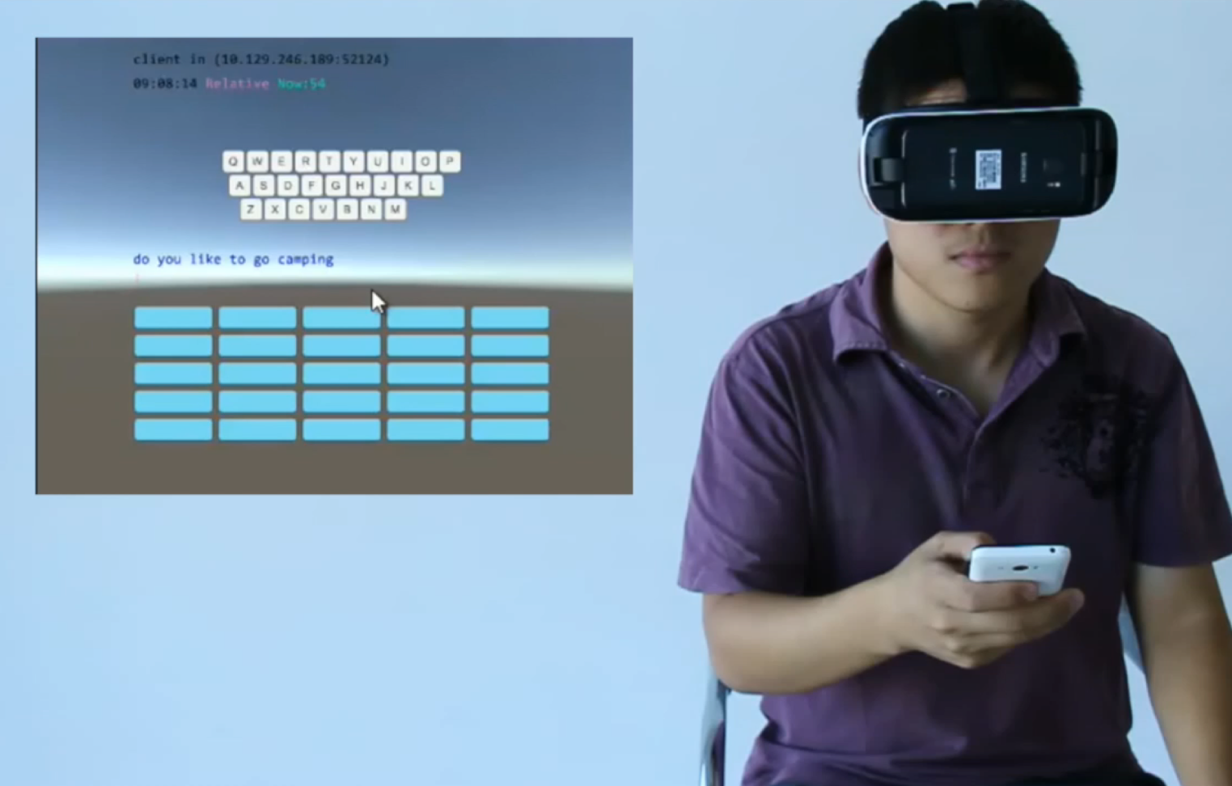
Goal: Evaluating the performance of the personalized algorithm
Participant: 16 (14 males and 2 female)
Task: Finish 20 phrases with each general technique, then finish another 20 with the personalized technique
Factor: Algorithm (absolute, relative),
Dependency (general, personalized)
Design: Same as Study 2
Study
3

Slide 38
 | GA | PA | GR | PR
Corrected Error | 8.03% | 8.02% | 6.11% | 5.96%
Uncorrected Error | 2.42% | 1.71% | 1.41% | 2.19%
Prediction Error | 4.76% | 3.67% | 2.44% | 2.26%
Could Not Enter | 0.93% | 0.62% | 0.17% | 0.32%
Study
3

Slide 39
Conclusion
Smartphone QWERTY users have the ability to type eyes-freely
Users need brief training to achieve a high typing speed
One-thumb eyes-free text entry achieves 23 WPM with acceptable error
The relative algorithm significantly improves the eyes-free typing
Personalization slightly improves the absolute algorithm

Slide 40
Conclusion
Users leverage mostly muscle memory instead of spatial memory
User keyboards follow the standard layout with various sizes and offsets
Users’ one-thumb typing behaviors likely follow the relative model

Slide 41
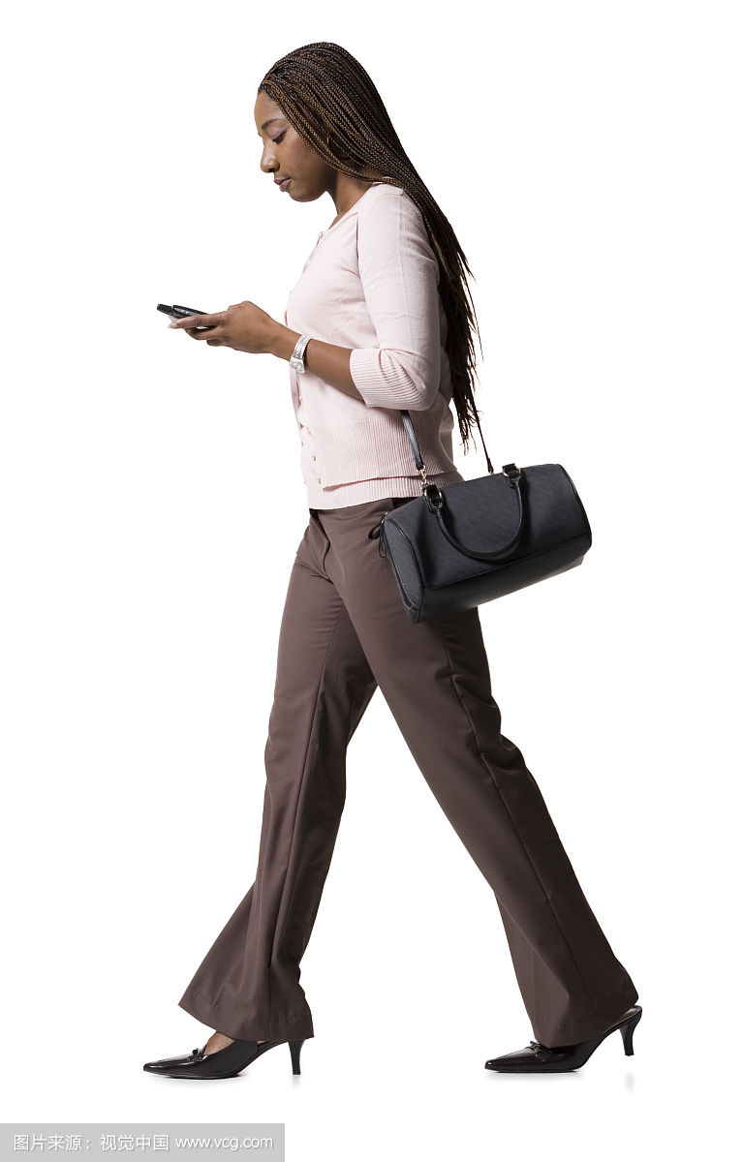
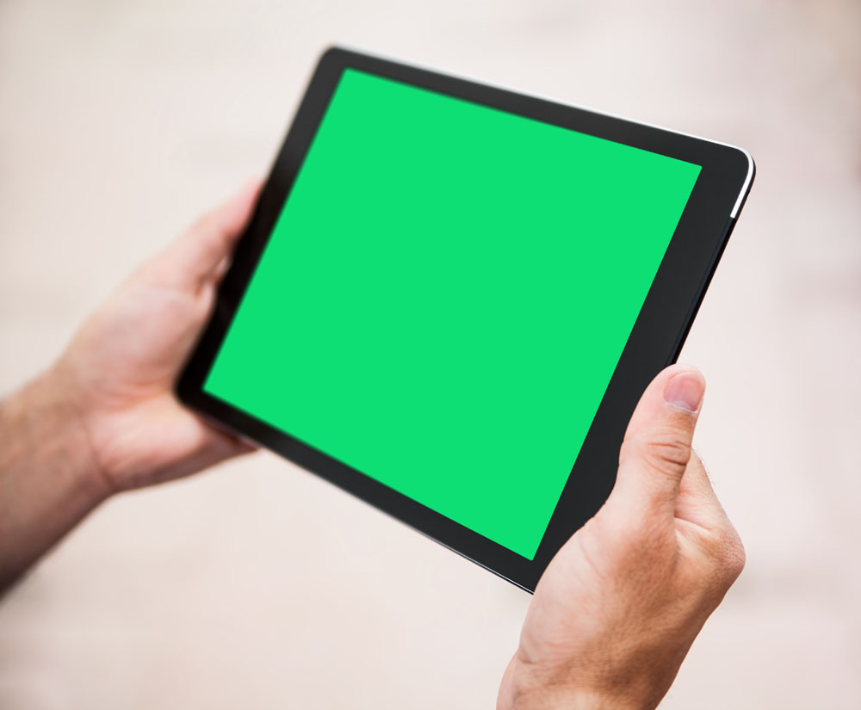
Future Work
Effects of the visual feedback
Effects of the size of handheld device
Key-based touch model
Sentence-level language model
Machine learning
Support out-of-vocabulary words
…

Slide 42
Thanks for listening
Q&A

